Slide 1

ECE 383 – Embedded Computer Systems II Lecture 18 – MicroBlaze + Custom IP
HQ U.S. Air Force Academy
Capt Jeffrey Falkinburg Room 2E46C 333-7366
I n t e g r i t y - S e r v i c e - E x c e l l e n c e
Notes:
Write on board:
ECE 315
Day 1 – Admin
Section Marcher
Introductions
Syllabus

Slide 2
Lesson Outline
Time Logs!
MicroBlaze + Custom IP

Slide 3
MicroBlaze + Custom IP

Slide 4
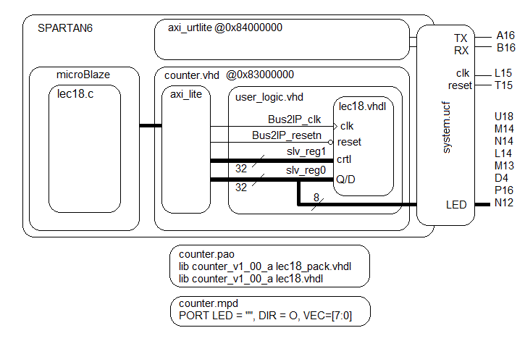
MicroBlaze + Custom IP

Slide 5
MicroBlaze + Custom IP – Workflow
The work flow has two main steps.
Define the hardware (microBlaze + custom IP) in EDK
Program the resulting hardware in the SDK environment.
Lets start with the first step.

Slide 6
Xilinx Platform Studio – EDK
This step requires that you defined the logical arrangement of the component in VHDL. Your entity description will contain two types of connections; those targeted at external ports on the Spartan6 chip and those intended to be accessible to the microBlaze processor.
Start new project called Lecture_18 and add the axi_uartlite
Base address

Slide 7
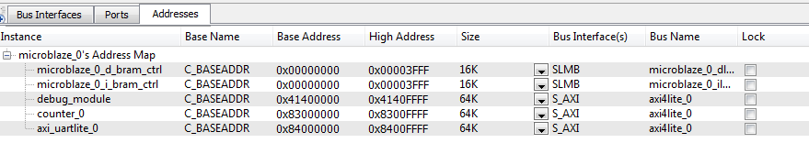
Xilinx Platform Studio – EDK
Start new project called Lecture_18 and add the axi_uartlite
Set base address to
Lecture 18 then says “Create first repository”

Slide 8
MicroBlaze + Custom IP

Slide 9
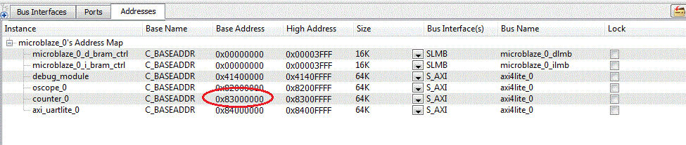
Xilinx Platform Studio – EDK
Add component from repository to project
Configure component
Base address

Slide 10
Xilinx Platform Studio – EDK
Connections to microBlaze
Add signals to user_logic port
For outputs: slv_regX <= signal;
For inputs: signal <= slv_regX;
Connections off chip
Add ports to Microprocessor Peripheral Definition (.mpd) file
Add signals to user_logic.vhd port
Add signals to counter.vhd port
Add ports to master.ucf file

Slide 11
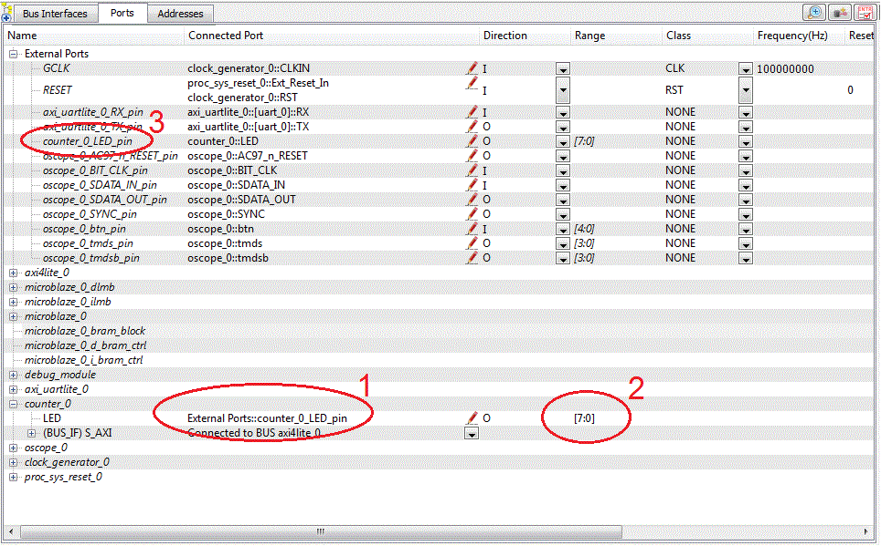
Xilinx Platform Studio – EDK

Slide 12
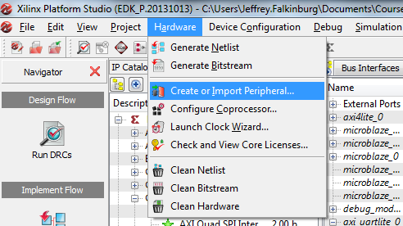
Custom IP
In Xilinx Platform Studio, go to Hardware → Create or Import Peripheral

Slide 13
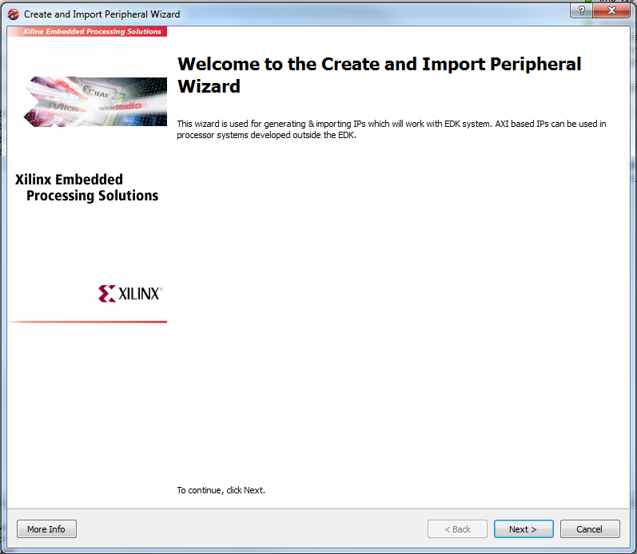
Custom IP

Slide 14
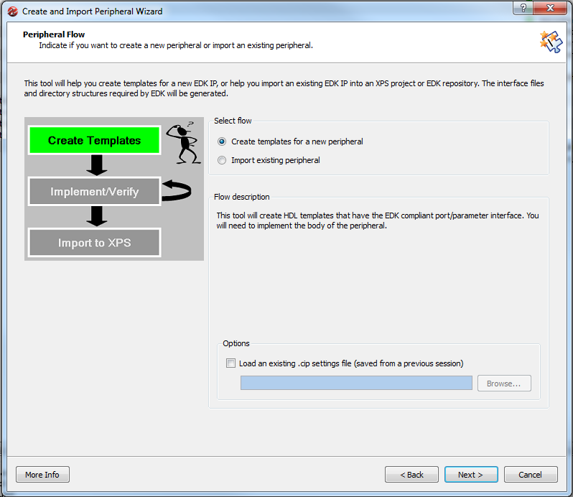
Custom IP

Slide 15
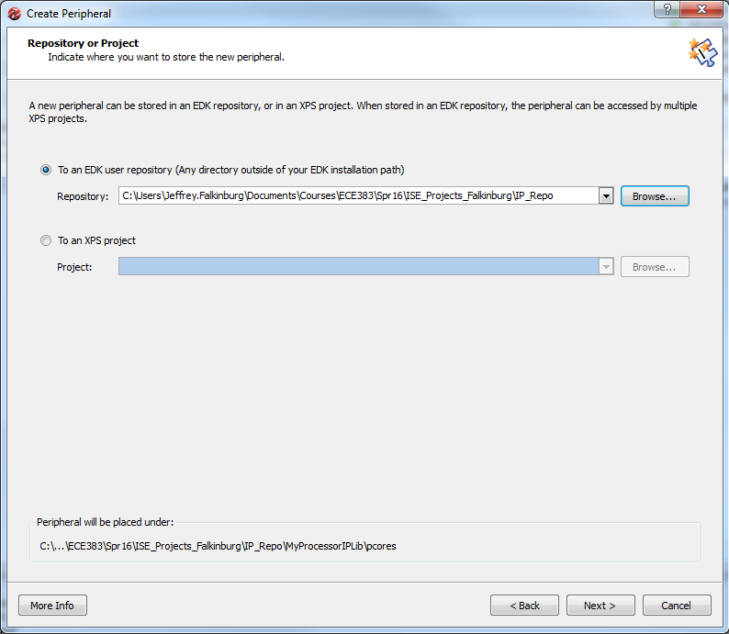
Custom IP
IP_Repo Folder should be in Bitbucket Repo

Slide 16
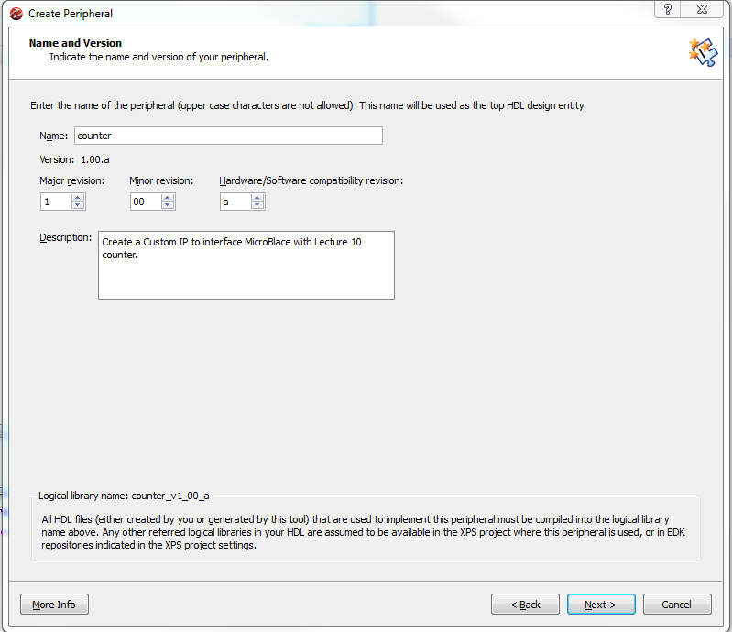
Custom IP

Slide 17
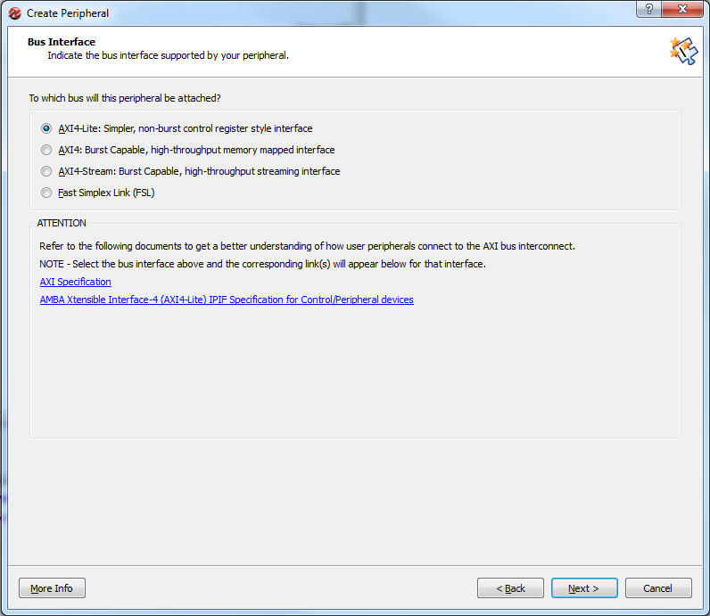
Custom IP

Slide 18
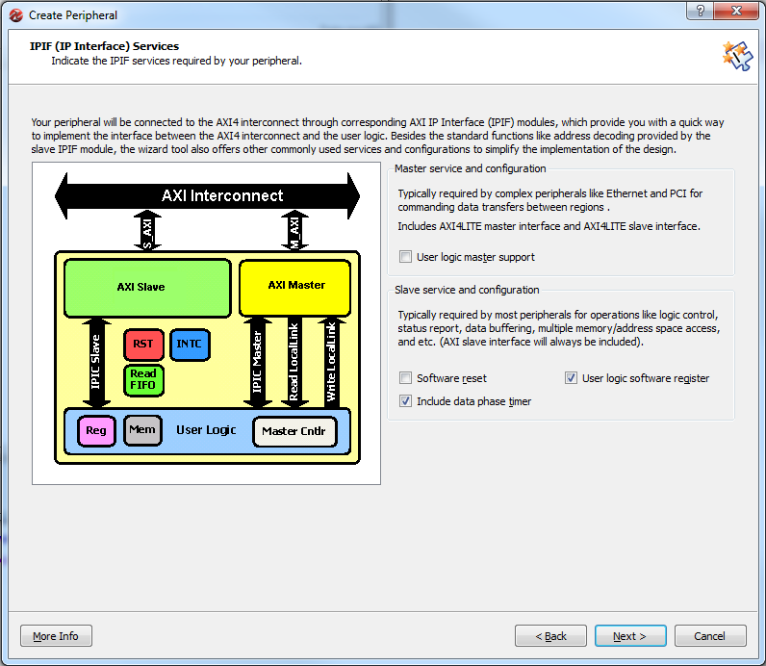
Custom IP

Slide 19
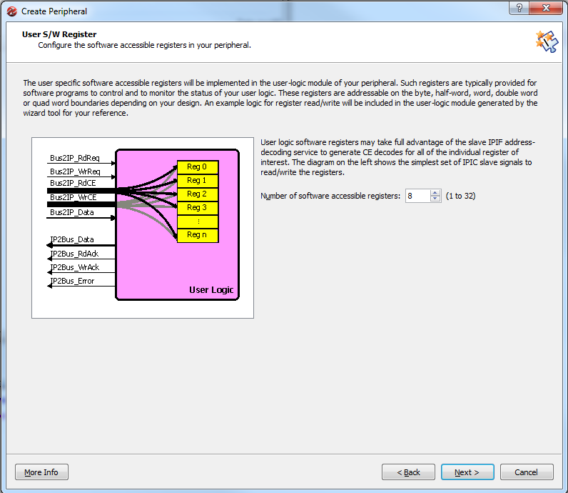
Custom IP

Slide 20
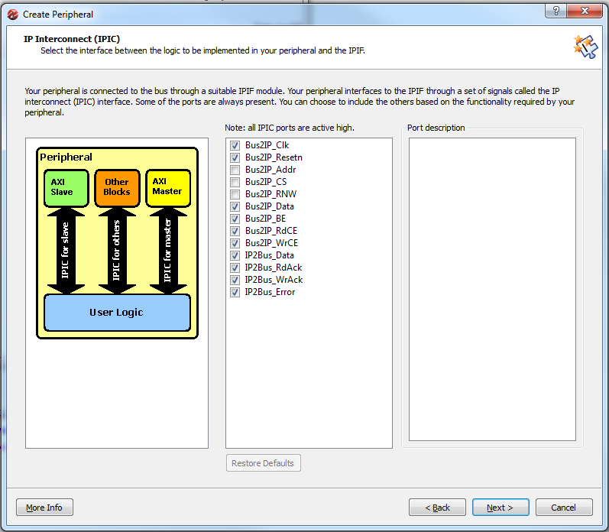
Custom IP

Slide 21
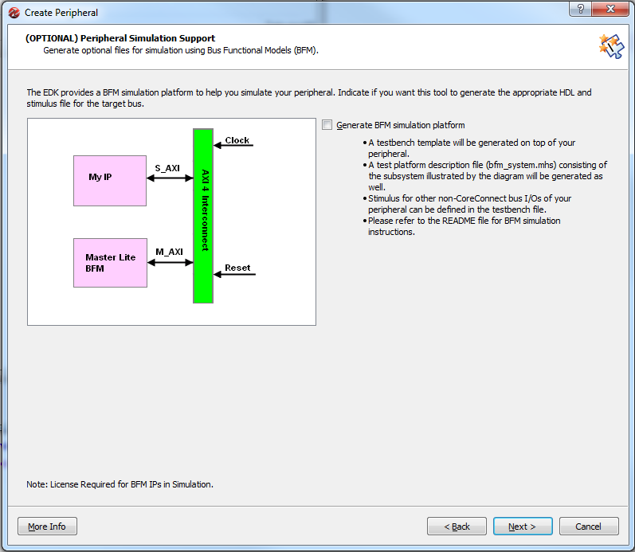
Custom IP

Slide 22
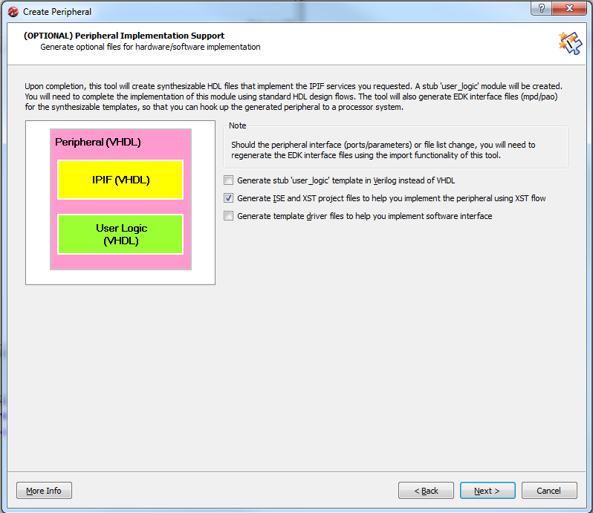
Custom IP

Slide 23
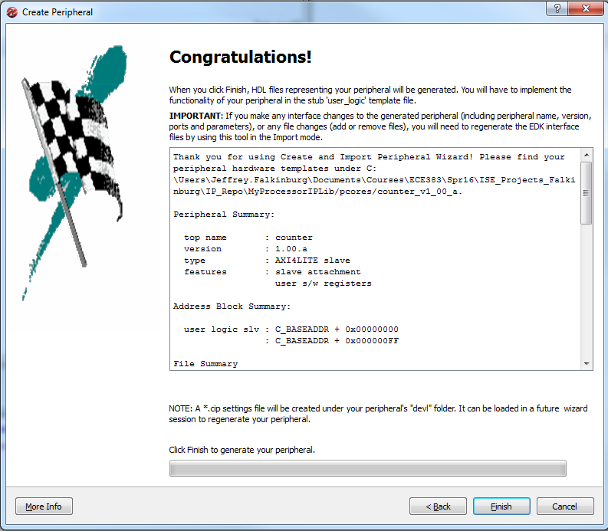
Custom IP

Slide 24
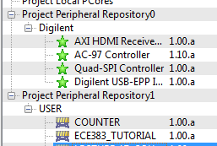
Custom IP

Slide 25
MicroBlaze + Custom IP

Slide 26
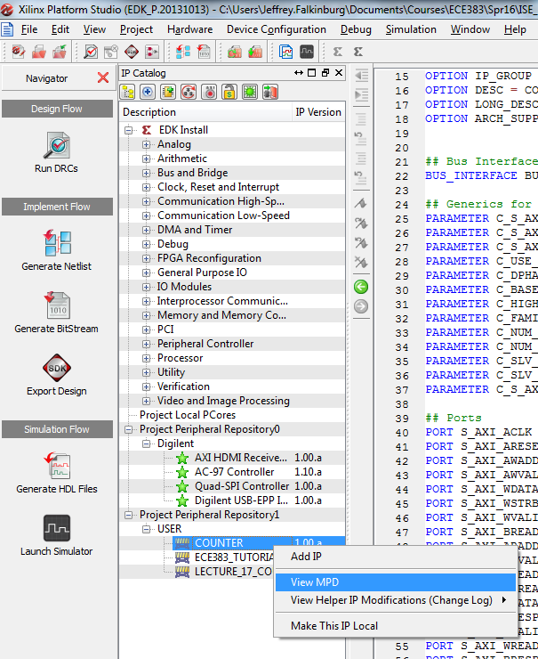
Modify *.mpd
The *.mpd file can be used to specify “ports” that will be connected to FPGA pins under the “Ports” tab of XPS.

Slide 27
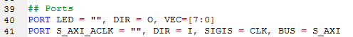
Modify *.mpd
The *.mpd file can be used to specify “ports” that will be connected to FPGA pins under the “Ports” tab of XPS.
PORT LED = "", DIR = O, VEC=[7:0]

Slide 28
Part 1a: Hardware Questions/ Notes related to handout
Note: the truth table for the counter is in the comments.
Q: In lec18.vhdl, what other library must be added?
Q: In lec18.vhdl, does the use work.lec18Parts.all library need to be added?

Slide 29
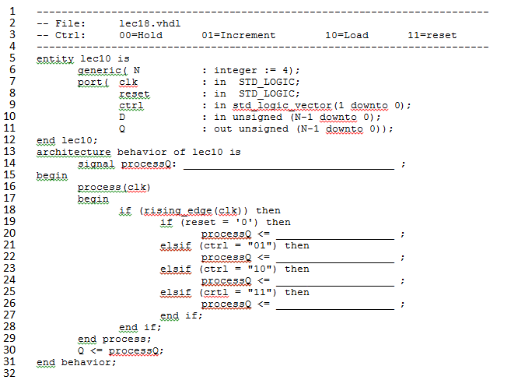
Lec18.vhdl – Counter

Slide 30
Download Pack File and lec18.vhd
Add Lecture 18 Pack file (lec18_pack.vhdl) and lec18.vhdl to pcore vhdl folder using this path:
Path_to_repo\IP_Repo\MyProcessorIPLib\pcores\counter_v1_00_a\hdl\vhdl\

Slide 31
MicroBlaze + Custom IP

Slide 32
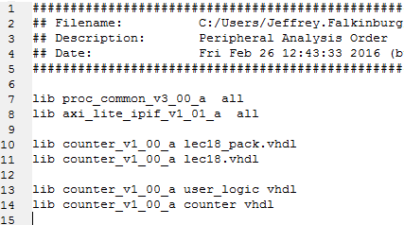
Modify *.pao
Add the lec18_pack.vhdl and lec18.vhdl to the *.pao
The *.pao file lists all the VHDL files you need to build your peripheral. If you add a separate file (e.g., video synchronization), you need to list it in this file. Order matters, so place the dependent files last.
lib counter_v1_00_a lec18_pack.vhdl
lib counter_v1_00_a lec18.vhdl

Slide 33
Part 1b: Hardware Questions/ Notes related to handout
Q: In user_logic.vhd, what do the generics C_NUM_REG, C_SLV_DWIDTH do?
Q: In user_logic.vhd, what two roles is slv_reg0 serving?
Q: In user_logic.vhd, what roles does slv_reg1 serve?
Q: In user_logic.vhd, slv_reg0 is on the left and right-hand side of an assignment. Identify the two lines where this happens.
Q: In user_logic.vhd, on line 62, what is the role does X"000000" serve?

Slide 34
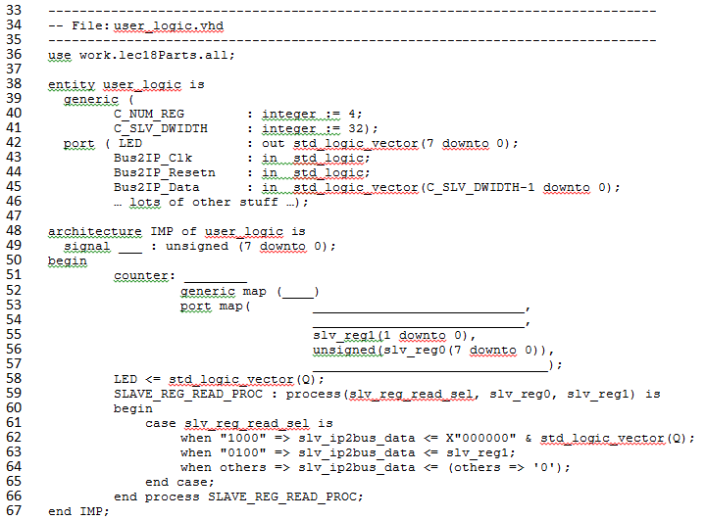
User_logic.vhd

Slide 35
MicroBlaze + Custom IP

Slide 36
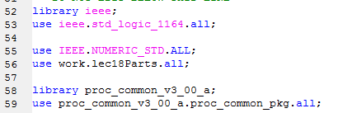
User_logic.vhd
Add lec18Parts to user_logic and remove unsigned and arithmetic libraries otherwise you will get an error saying unsigned is declared multiple times
use IEEE.NUMERIC_STD.ALL;
use work.lec18Parts.all;

Slide 37
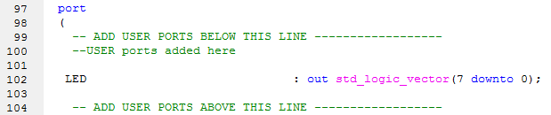
User_logic.vhd
Add User Port for LEDs

Slide 38
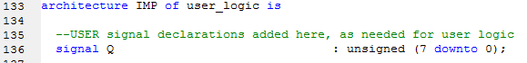
User_logic.vhd
Add User Signal for Q

Slide 39
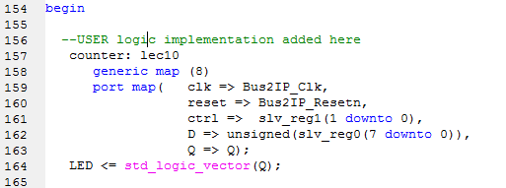
User_logic.vhd
Add Counter Port Map and LED assignment for user logic
counter: lec10
generic map (8)
port map( clk => Bus2IP_Clk,
reset => Bus2IP_Resetn,
ctrl => slv_reg1(1 downto 0),
D => unsigned(slv_reg0(7 downto 0)),
Q => Q);
LED <= std_logic_vector(Q);

Slide 40
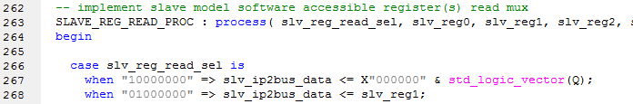
User_logic.vhd
Add read signal Q on slv_reg0 when using 8 slave registers:
case slv_reg_read_sel is
when "10000000" => slv_ip2bus_data <= X"000000" & std_logic_vector(Q);

Slide 41
MicroBlaze + Custom IP

Slide 42
Part 1c: Hardware Questions/ Notes related to handout
Q: If you want a signal to go outside the Spartan chip...
What files must it appear on the entity description?
What other files must contain information about the signal?
Q: If you want a signal to go to the microBlaze...
What files must it appear on the entity description?
In order for the microBlaze to read the signal, what must you do?
In order for the microBlaze to write to the signal, what must you do?

Slide 43
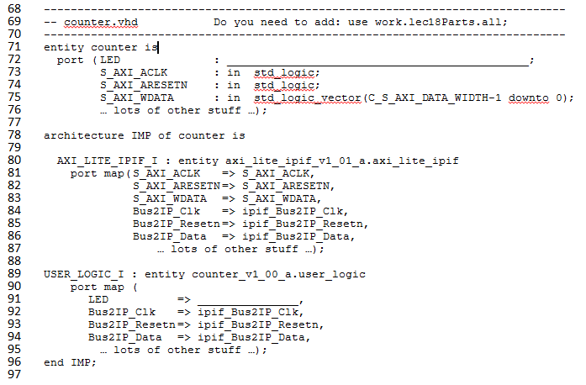
Counter.vhd

Slide 44
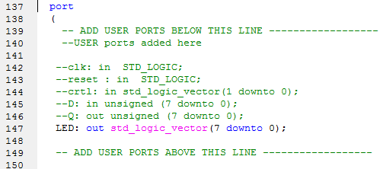
Counter.vhd

Slide 45
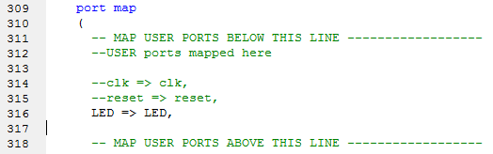
Counter.vhd

Slide 46
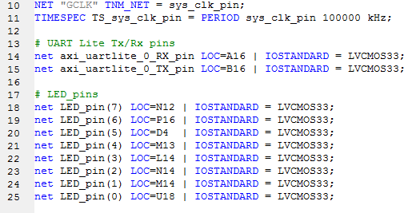
System.ucf
Add UART Lite pins and LED pins to System.ucf
# UART Lite Tx/Rx pins
net axi_uartlite_0_RX_pin LOC=A16 | IOSTANDARD = LVCMOS33;
net axi_uartlite_0_TX_pin LOC=B16 | IOSTANDARD = LVCMOS33;
# LED_pins
net LED_pin(7) LOC=N12 | IOSTANDARD = LVCMOS33;
net LED_pin(6) LOC=P16 | IOSTANDARD = LVCMOS33;
net LED_pin(5) LOC=D4 | IOSTANDARD = LVCMOS33;
net LED_pin(4) LOC=M13 | IOSTANDARD = LVCMOS33;
net LED_pin(3) LOC=L14 | IOSTANDARD = LVCMOS33;
net LED_pin(2) LOC=N14 | IOSTANDARD = LVCMOS33;
net LED_pin(1) LOC=M14 | IOSTANDARD = LVCMOS33;
net LED_pin(0) LOC=U18 | IOSTANDARD = LVCMOS33;

Slide 47
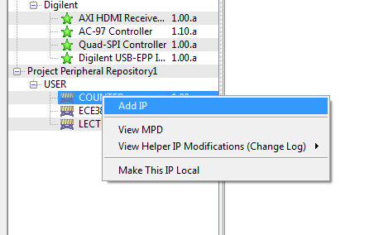
Adding Custom IP

Slide 48
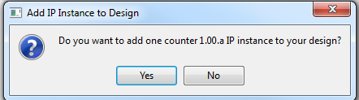
Adding Custom IP

Slide 49
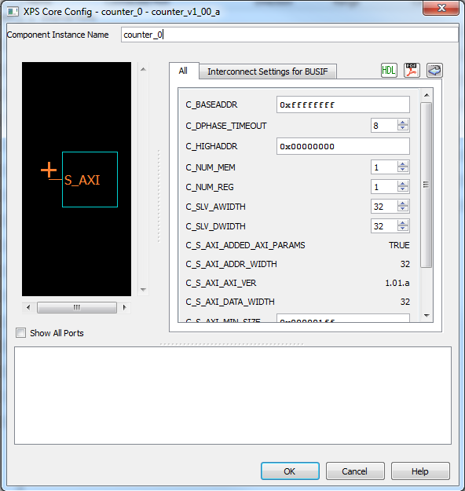
Adding Custom IP

Slide 50
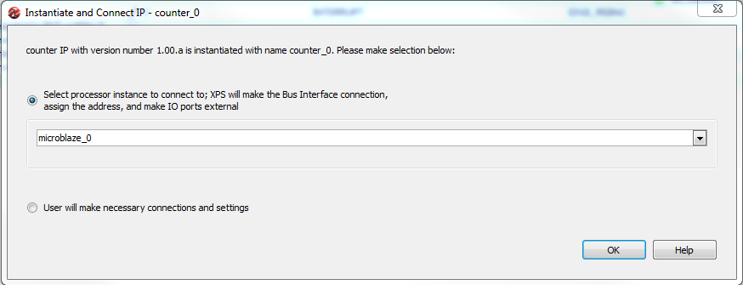
Adding Custom IP

Slide 51
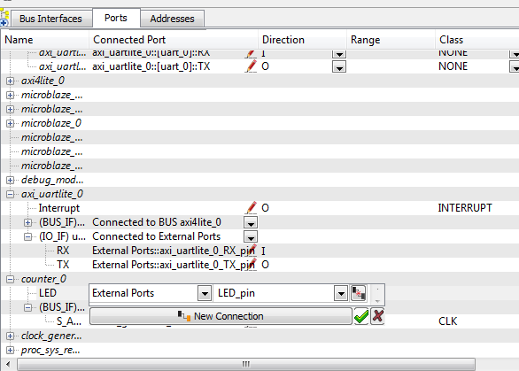
Adding Custom IP

Slide 52
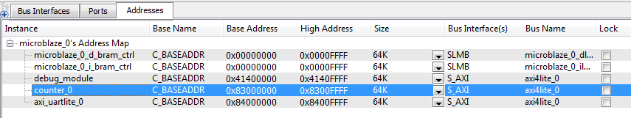

Adding Custom IP
Increase BRAM size to 16k or 64k
Set Counter address to 0x83000000
Set axi_uartlite_0 address to 0x84000000

Slide 53
Export Design
Export Design and take a coffee break while it builds

Slide 54
Part 1: Hardware Questions/ Notes related to handout
Note: the truth table for the counter is in the comments.
Q: In lec18.vhdl, what other library must be added?
Q: In lec18.vhdl, does the use work.lec18Parts.all library need to be added?
Q: In user_logic.vhd, what do the generics C_NUM_REG, C_SLV_DWIDTH do?
Q: In user_logic.vhd, what two roles is slv_reg0 serving?
Q: In user_logic.vhd, what roles does slv_reg1 serve?
Q: In user_logic.vhd, slv_reg0 is on the left and right-hand side of an assignment. Identify the two lines where this happens.

Slide 55
Part 1: Hardware Questions/ Notes related to handout
Q: In user_logic.vhd, on line 62, what is the role does X"000000" serve?
Q: If you want a signal to go outside the Spartan chip...
What files must it appear on the entity description?
What other files must contain information about the signal?
Q: If you want a signal to go to the microBlaze...
What files must it appear on the entity description?
In order for the microBlaze to read the signal, what must you do?
In order for the microBlaze to write to the signal, what must you do?

Slide 56
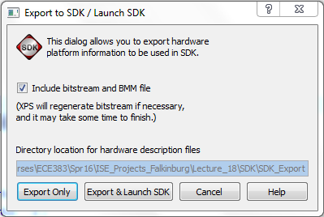
Export Design
Export & Launch SDK…assuming no errors

Slide 57
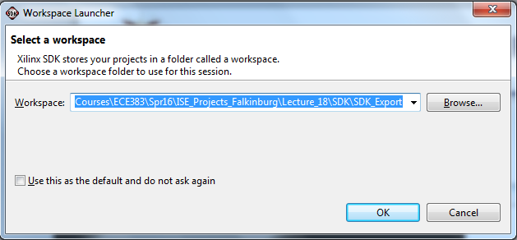
Export to SDK Folder

Slide 58
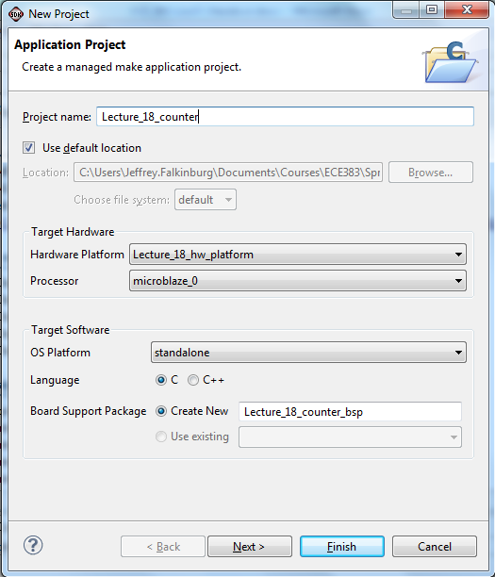
New SDK Project

Slide 59
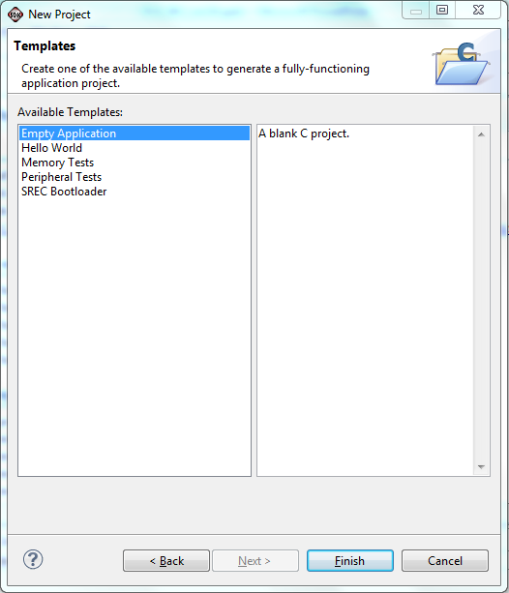
New SDK Project

Slide 60
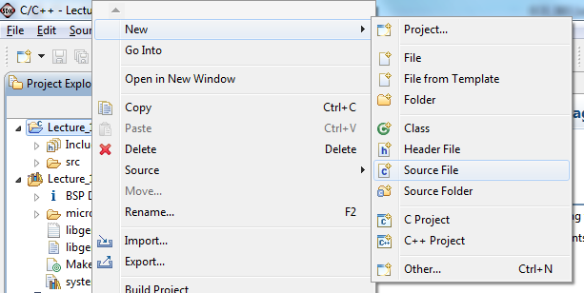
New C Source File

Slide 61
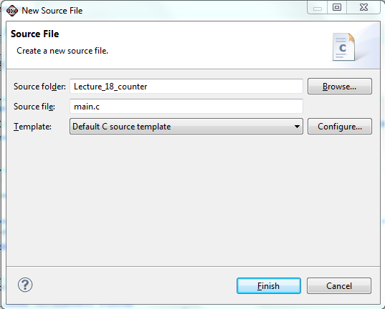
New C Source File

Slide 62
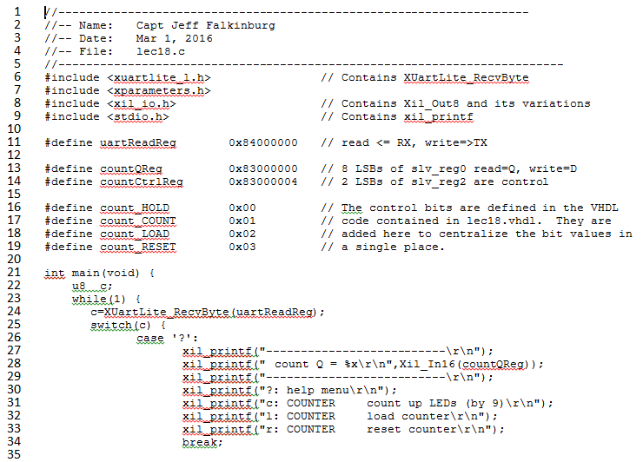
Lec18.c

Slide 63
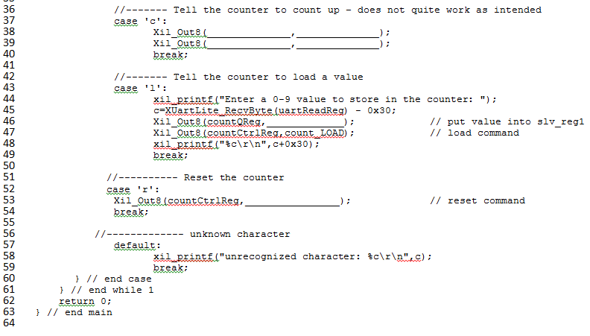
Lec18.c

Slide 64
Part 2: Software Questions/ Notes related to handout
Why doesn't the 'c' command cause the counter to count up by 1?
On line 46, why did I subtract 0x30?
After loading the counter on line 48, something should be done that is missing.
What line of VHDL code in user_logic.vhd is "activated" when line 28 executes?
What line of VHDL code in user_logic.vhd is "activated" when line 53 executes?
What line of VHDL code in lec18.vhdl "activated" when line 53 executes?
What appears to be the naming convention for hardware registers?

Slide 65
Add C code to Source File
#include <xuartlite_l.h> // Contains XUartLite_RecvByte
#include <xparameters.h>
#include <xil_io.h> // Contains Xil_Out8 and its variations
#include <stdio.h> // Contains xil_printf
#define uartReadReg 0x84000000 // read <= RX, write=>TX
#define countQReg 0x83000000 // 8 LSBs of slv_reg0 read=Q, write=D
#define countCtrlReg 0x83000004 // 2 LSBs of slv_reg2 are control
#define count_HOLD 0x00 // The control bits are defined in the VHDL
#define count_COUNT 0x01 // code contained in lec18.vhdl. They are
#define count_LOAD 0x02 // added here to centralize the bit values in
#define count_RESET 0x03 // a single place.
int main(void) {
u8 c;
while(1) {
c=XUartLite_RecvByte(uartReadReg);
switch(c) {
//-------------------------------------------------
// Reply with the help menu
//-------------------------------------------------
case '?':
xil_printf("--------------------------\r\n");
xil_printf(" count Q = %x\r\n",Xil_In16(countQReg));
xil_printf("--------------------------\r\n");
xil_printf("?: help menu\r\n");
xil_printf("o: k\r\n");
xil_printf("c: COUNTER count up LEDs (by 9)\r\n");
xil_printf("l: COUNTER load counter\r\n");
xil_printf("r: COUNTER reset counter\r\n");
xil_printf("f: flush terminal\r\n");
break;
//-------------------------------------------------
// Basic I/O loopback
//-------------------------------------------------
case 'o':
xil_printf("k \r\n");
break;
//-------------------------------------------------
// Tell the counter to count up
//-------------------------------------------------
case 'c':
Xil_Out8(countCtrlReg,count_COUNT);
Xil_Out8(countCtrlReg,count_HOLD);
break;
//-------------------------------------------------
// Tell the counter to load a value
//-------------------------------------------------
case 'l':
xil_printf("Enter a 0-9 value to store in the counter: ");
c=XUartLite_RecvByte(uartReadReg) - 0x30;
Xil_Out8(countQReg,c); // put value into slv_reg1
Xil_Out8(countCtrlReg,count_LOAD); // load command
xil_printf("%c\r\n",c+0x30);
break;
//-------------------------------------------------
// Reset the counter
//-------------------------------------------------
case 'r':
Xil_Out8(countCtrlReg,count_RESET); // reset command
break;
//-------------------------------------------------
// Clear the terminal window
//-------------------------------------------------
case 'f':
for (c=0; c<40; c++) xil_printf("\r\n");
break;
//-------------------------------------------------
// Unknown character was
//-------------------------------------------------
default:
xil_printf("unrecognized character: %c\r\n",c);
break;
} // end case
} // end while 1
return 0;
} // end main

Slide 66
Add C code to Source File
while(1) {
c=XUartLite_RecvByte(uartReadReg);
switch(c) {
//-------------------------------------------------
// Reply with the help menu
//-------------------------------------------------
case '?':
xil_printf("--------------------------\r\n");
xil_printf(" count Q = %x\r\n",Xil_In16(countQReg));
xil_printf("--------------------------\r\n");
xil_printf("?: help menu\r\n");
xil_printf("o: k\r\n");
xil_printf("c: COUNTER count up LEDs (by 9)\r\n");
xil_printf("l: COUNTER load counter\r\n");
xil_printf("r: COUNTER reset counter\r\n");
xil_printf("f: flush terminal\r\n");
break;

Slide 67
Add C code to Source File
//-------------------------------------------------
// Basic I/O loopback
//-------------------------------------------------
case 'o':
xil_printf("k \r\n");
break;
//-------------------------------------------------
// Tell the counter to count up
//-------------------------------------------------
case 'c':
Xil_Out8(countCtrlReg,count_COUNT);
Xil_Out8(countCtrlReg,count_HOLD);
break;
//-------------------------------------------------
// Tell the counter to load a value
//-------------------------------------------------
case 'l':
xil_printf("Enter a 0-9 value to store in the counter: ");
c=XUartLite_RecvByte(uartReadReg) - 0x30;
Xil_Out8(countQReg,c); // put value into slv_reg1
Xil_Out8(countCtrlReg,count_LOAD); // load command
xil_printf("%c\r\n",c+0x30);
break;

Slide 68
Add C code to Source File
//-------------------------------------------------
// Reset the counter
//-------------------------------------------------
case 'r':
Xil_Out8(countCtrlReg,count_RESET); // reset command
break;
//-------------------------------------------------
// Clear the terminal window
//-------------------------------------------------
case 'f':
for (c=0; c<40; c++) xil_printf("\r\n");
break;
//-------------------------------------------------
// Unknown character was
//-------------------------------------------------
default:
xil_printf("unrecognized character: %c\r\n",c);
break;
} // end case
} // end while 1
return 0;
} // end main

Slide 69
Xilinx Software Development Kit - SDK
In the SDK environment, you program the hardware built in the previous step.
The key concept here is that the peripheral defined in EDK are accessible through the slave registers as memory mapped devices.
For example, I assigned counter_0 to have a BaseAddress 0x83000000. In the user_logic.vhdl file, I (arbitrarily) assigned counter ports to slave register according to the table below.
Signal | direction | Slave Register | Address
D | input | slv_reg0(7 downto 0) | 0x83000000
ctrl | input | slv_reg1(1 downto 0) | 0x83000004
Q | output | slv_reg0(7 downto 0) | 0x83000000

Slide 70
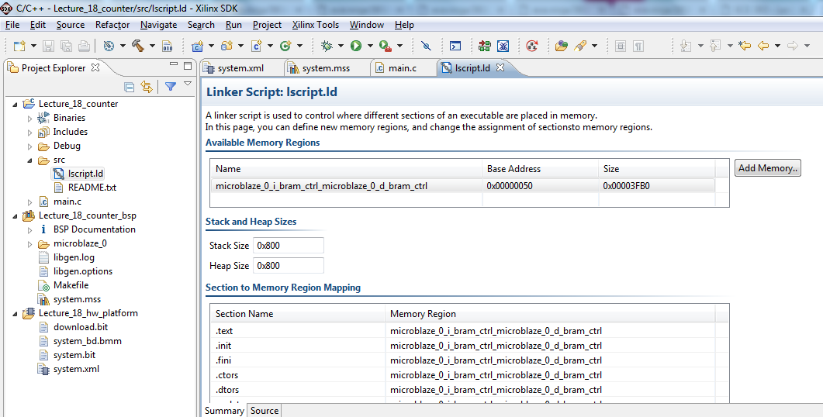
Increase Stack and Heap Size

Slide 71
Configure JTAG Settings
Go to Xilinx Tools → Configure JTAG Settings (You may get a pop-up requesting admin access for this step)
Under “Type,” select “Digilent USB Cable” and then click “OK” (You have to do this for every new project!)
71

Slide 72
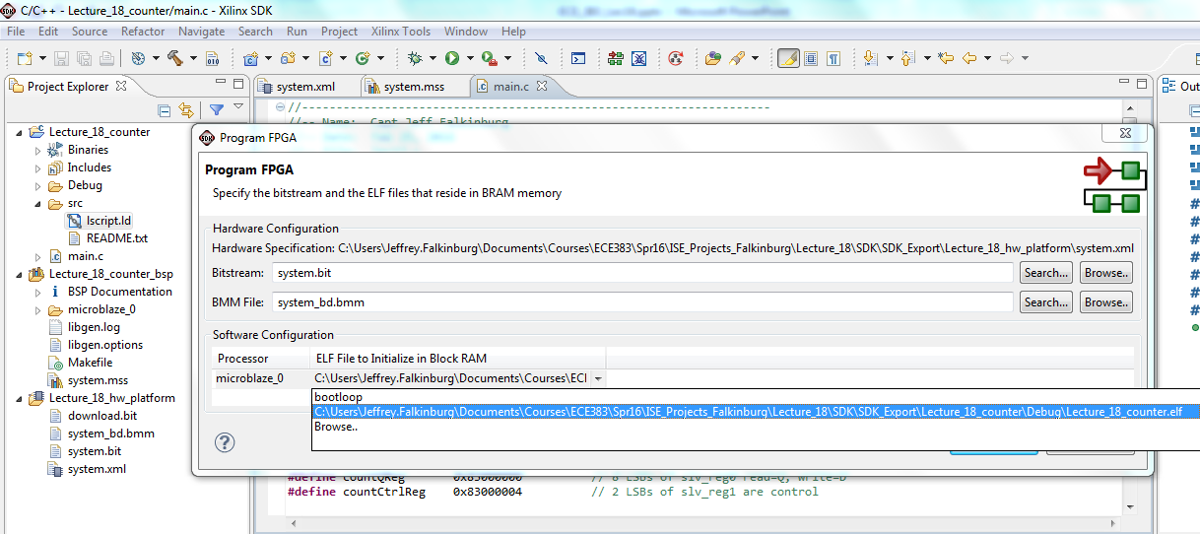
Build and Export to FPGA
72

Slide 73
MicroBlaze + Custom IP

